Slide 1
Early Childhood Education Finance: Making Ends Meet in a Recession Economy
Smart Start Conference
May 2, 2013
Louise Stoney Alliance for Early Childhood Finance Opportunities Exchange

Slide 2
ECE is Market-Based: Most Revenue is Tuition & Fees
Consumer tuition is the largest source of revenue, roughly 57% of total industry receipts
Private sector revenue has increased dramatically but still less than 4% of total
Government funding
@ 39% of total, and
is primarily portable
funding (vouchers or tax benefits)
Notes:
2
2
Use this slide to help reinforce the extent to which ECE is a market-based, tuition-driven system.
YES, there is direct subsidy for Head Start and public prek but most government funding for ECE is portable tuition (e.g. subsidy follows the child to whatever provider is chosen) and most ECE services are delivered in by private sector entites.
So…even government funding for ECE is, by and large, market driven

Slide 3
The Iron Triangle: Managing Revenues and Costs
Full Enrollment
Revenues Cover Per-Child Cost
Full Fee Collection
Ensure full enrollment, every day in every classroom
Collect tuition and fees, in full and on time
Revenue covers per-child cost (tuition, fees, and 3rd-party funding)

Slide 4
Intensive focus on “Iron Triangle”
95% enrollment
Only 2% uncollectible debts
Very difficult to achieve with high subsidy co-pays, low absence policy & no targeting
Very difficult to achieve in smaller centers

Slide 5
Why is Financial Management Important?
Financing isn’t just about increasing government or private sector dollars for ECE; it’s about ECE program capacity to actually tap all available funds
Poor fiscal management is the #1 reason why ECE programs fail
Even programs with strong ERS and QRIS scores may fail to see fiscal trouble until it’s too late.
Being able to manage costs and revenues can help weather unexpected developments, and plan for a viable future.

Slide 6
Managing Full Enrollment

Slide 7
Notes:
EXPLAIN each axis: vertical is the net annual revenue (+/-); horizontal is %ages of enrollment. 4 colored lines are centers of different quality levels
Use this slide as a quick reference for showing how much enrollment affects the bottom line. Don’t let folks get lost in the forest….just keep to the high points

Slide 8
Managing Full Enrollment
Ensure enrollment every day, all day, in every classroom
Monitor enrollment relative to budgets
Centralize enrollment management (application process, subsidy eligibility, child information, center policies, etc.)
Maximize automation for information management and tracking targets
Market actively and Maintain wait lists
Coordinate with Alliance partners, e.g. share wait lists, refer families

Slide 9
Enrollment Staffing Examples
Early Connections (2-person Enrollment Department for 6 sites)
Intake: determine eligibility and complete paperwork for subsidy, PreK, etc.
Review Alliance-wide procedures and policies
Maintain up-to-date vacancy and enrollment data for each site
Kidango (52-site organization)
Online enrollment on website
Central office collects and audits enrollment documents, and monitors classroom enrollment levels and expected changes, resulting in no lapse between a child leaving and a new child filling that slot.
Infant-Toddler FDC (100+ FCC homes)
Central office recruits families
Online enrollment on website
CCCRC (Loraine, Ohio) Shared Solutions Alliance
Enrollment Management & Marketing Support for members

Slide 10
Managing Full Enrollment: Tools
Automation is a KEY RESOURCE for managing full enrollment. Specific supports include:
Enrollment report from automated software (like ProCare or Child Care Manager) run & reviewed on a weekly basis
On-line enrollment for new families
Staff 88 or other software for scheduling classroom staff
Notes:
talk about data benchmarks so folks understand that it is a living tool that you use on a weekly basis.

Slide 11
Policy Strategies for Full Enrollment
“Shrink” ECE markets (e.g. require minimum QRIS rating for subsidy)
Target dollars to highest quality ECE providers
Contract for a specific # of slots, either with selected provider or an Alliance (network) of providers
Limited Purchase of Service vouchers only for higher quality programs
Collaborative ventures with other public & private funders
Simplify subsidy enrollment policies
So eligibility determination/re-determination can happen more quickly
Promote Shared Service Alliances
to support ‘economies of specialization’ in enrollment/child recruitment

Slide 12
Full Fee Collection

Slide 13
Managing Full Fee Collection
Collect fees/revenues in full and on time
Delineate a clear late fee policy; explain to parents when they enroll; create internal policy to ensure it is enforced.
Assign someone – other than the site director – to follow-up with families ASAP if fees aren’t paid on time
Use technology/automation to:
Generate bills
Alert parents about pending late fee
Track payments, aging, etc.
Track and manage subsidy challenges (e.g. authorization, absence days, reconciliation, errors)

Slide 14
Fee Collection Staffing Examples
Children’s Home/Chambliss Shelter: 2-person finance department
Bills prepared by Finance Department
Parent fees collected at each site by central staff, who oversee the ten contract sites.
Center personnel are not involved in fee collection.
Early Connections: Billing Specialist and Finance Assistant
Bills generated by ProCare
Billing Specialist tracks, manages, and reconciles bills and subsidy payments.
Finance Assistant collects cash and checks at each site, contacts late parents.
Center personnel are not involved in fee collection.
CCRC (Loraine, Ohio) Shared Solutions Alliance
Tuition Pay Direct + weekly reconciliation & debt collection
Notes:
IS THERE ANYTHING WE CAN SAY ABOUT WHAT KATY does? E.g. is there anything helpful in a ‘lighter touch’ model?

Slide 15
Policy Strategies for Full Fee Collection
Co-payments based on a % of income, for all children, vs based on price of care for each child
Consider waiving/lowering co-pays for higher quality programs
Subsidy reimbursement based on enrollment vs attendance
or a fair & balanced policy that takes extended illness and the instability of the family into consideration
Maximize automation
Enable/encourage on-line billing for public & private fees
Promote Shared Service Alliances
to support ‘economies of specialization’ in fee collection, collaborative technology systems, etc.

Slide 16
The Consequences of High Co-Payments: One State Example
ECE provider cost model included high uncollected debt (15% vs. typical 3-5%) because:
Subsidy reimbursement for only 2 absence days
Very high parent fees, even with subsidy: co-pay + gap
Louisiana Example: Family of 4, parents earn minimum wage,
annual income $30,160
Weekly rates | Infant | 3-Year Old | Total
Tuition | $150.00 | $135.00 | $285.00
CCAP rate ceiling | $92.50 | $87.50 | $180.00
CCAP reimbursement – 40% of max | $37.00 | $35.00 | $72.00
Total cost to parent | $113.00 | $100.00 | $213.00
Parent cost % of weekly income | 19.5% | 17.2% | 36.7%

Slide 17
Revenues Cover Costs

Slide 18
Revenues Must Cover Costs
First, need to understand, and manage, costs
Knowing what costs are, and how they differ by age group and classroom, can make the difference between losing money or not.
Determine if revenues cover costs
If revenues do not cover costs, need to:
Reduce costs – by combining or closing classrooms, sharing administrative/management/support staff, lower OTPS, etc.
Raise revenues – through additional fundraising or boosting enrollment and fee collection. [Note: Cost modeling suggests that CACFP is an extremely important revenue source in many cases.]
Or both
Notes:
LIBBIE – the info in red may not belong HERE, in this slide, but I think it’s really important to reinforce that reducing costs doesn’t just mean buying less paper or eliminating conferences and that raising revenues doesn’t just mean writing a grant

Slide 19
Example from Cost Modeling Center: 106 children, infants, toddlers & preschoolers
Notes:
Here’s what the excel summary spreadsheet looks like –
RESOURCE: generic cost model (word and excel files)

Slide 20
Policy Options: The Cost-Quality Gap
Higher quality ECE costs more than lower quality (higher degrees, lower ratios, etc.)
Typical answer – to raise public reimbursement rates – is a simplistic response to a complex problem
Effective policy rooted in deeper understanding of ECE finance from provider perspective:
How to increase program operating revenues while acknowledging that child care markets are price sensitive?
How to effectively structure rules for blending funds from multiple sources?

Slide 21
How Cost Modeling Can be Used
Enables exploration of how various factors can affect profit or loss, e.g.:
Increased scale (number of children served)
Income mix of families served
Enrollment level relative to capacity
Fee collectability
Subsidy policy changes
Revenue sources, e.g. state-funded PreK or QRIS
Enables modeling budget for a proposed center or group of centers

Slide 22
Cost per child varies 48% between lowest and highest quality level, based on differences in staffing, salaries and benefits

Slide 23
Cost per child varies 81% between lowest and highest quality level, based on variations in class size, staffing, salaries, and benefits.

Slide 25
Intensive focus on “Iron Triangle”: 95% enrollment, only 2% uncollected. Very difficult to achieve in smaller centers.
Notes:
Discussion: Shared Services Alliance

Slide 26
Alliance Examples: Ensuring Revenues Cover Costs

Slide 27
The Many Roles of an ECE Center Director
Most centers are very small (national average is 75 children.)
The typical child care center director is responsible for multiple tasks.
Notes:
But given our current ECE business model how can an ECE program director possibly provide pedagogical leadership

Slide 28
Role of Shared Services
Economies of scale
Sharing staff eliminates duplication of effort
Automation/technology reduces time on task and errors, and enables pooled effort (e.g. subsidy administration)
Joint planning and procurement can reduce costs – lower prices and reduced duplication
Economies of specialization
Focus on one task allows for greater expertise and efficiency
Sharing tasks across organizations allows professionals to do more of what they like to do and do best
Moving administrative tasks to a central office allows directors to focus on pedagogical leadership

Slide 29
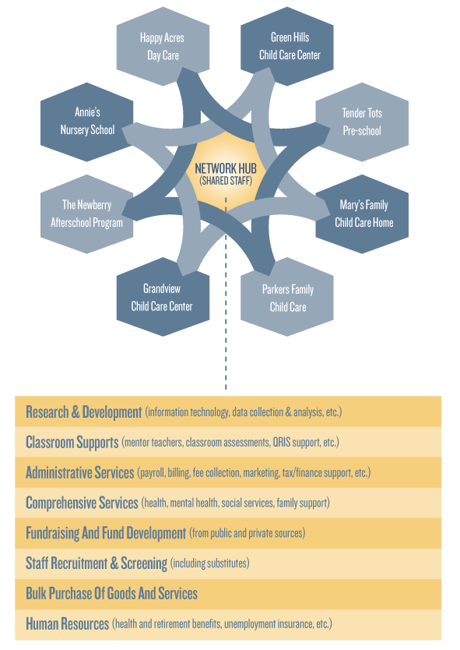
What is Shared Services in ECE?
Business Leadership: Stronger fiscal management, centralized administration, shared purchasing, staffing, tools & templates etc.
Pedagogical Leadership for classrooms, e.g. time & supervision for reflective practice, shared mentoring, learning communities across sites, new models of leadership, etc.
Notes:
What do we mean by SS? Usually people think of it just in economic terms, as a way to save $. But it’s always been about resource reallocation: saving time and money, and putting those into quality.
Language from OE - Building Quality, Leadership and Management Capacity in Early Care and Education Through Shared Services - We seek to build strong, effective ECE programs that are able to ensure positive child outcomes by promoting Shared Services as a framework for pedagogical leadership and sound business management. … focusing on capacity-building as a collective endeavor, spreading costs, sharing staff and restructuring leadership among multiple sites.

Slide 30
A Range of Services & Entry Points
Shared Services on the Web
Intensive Shared Services
many options in between

Slide 31
Shared Services: Scale at Many Levels
National
Shared Services on the Web (generic)
Cost savings, tools, R&D
State
Shared Services on the Web (customized)
QRIS links, state R&D, state-specific tools, cost savings
Local
Shared Staff (administrative and/or program)
Support for marketing, enrollment
Local cost savings (janitorial, etc.)

Slide 32
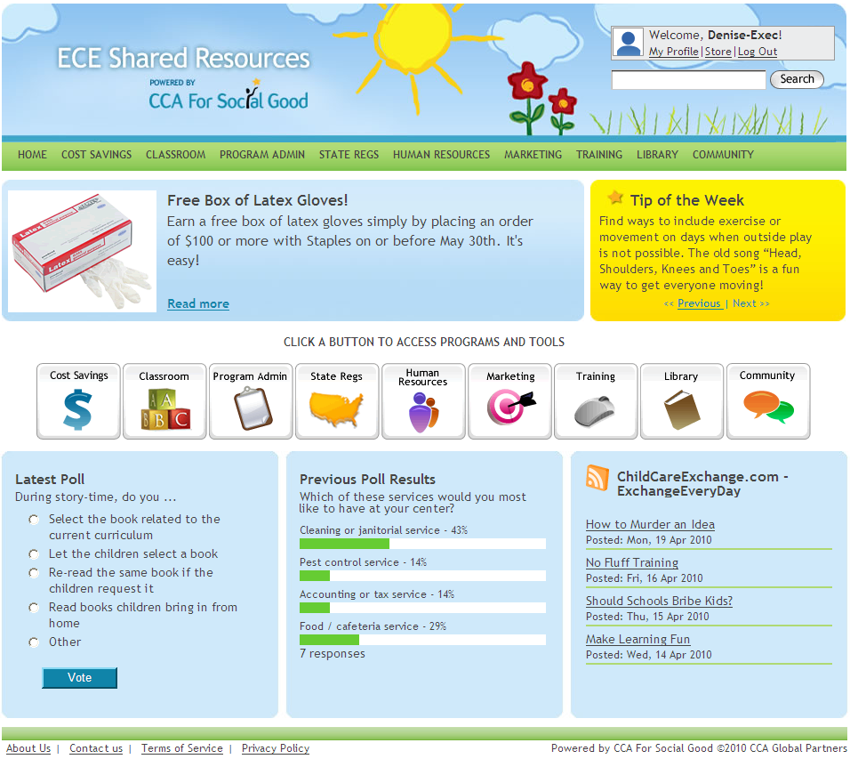
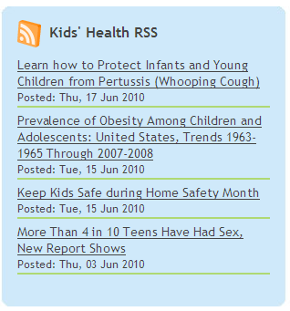

Slide 33
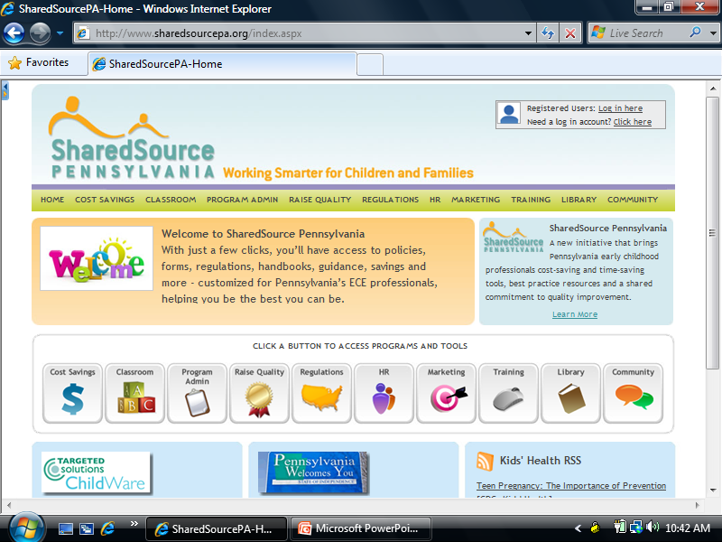
Information regarding Keystone STARS is available in the
“Raise Quality” section of the Shared Source PA website.

Slide 34
Shared Services Resources
Opportunities Exchange: www.opportunities-exchange.org
Profiles of current alliances
Tools, such as examples of management agreements
Articles and presentations
Videos and multi-media
Searchable database
ECE Shared Resources national web portal: www.ecesharedresources.com
Alliance for Early Childhood Finance: www.earlychildhoodfinance.org

Slide 35
Extra Slides – in Case I Need Them

Slide 36
Quantity AND Quality some thoughts on policy options
What if you served the same number of children in fewer settings – with a focus on high-quality programs?
This would not cut access, nor would it increase rates, but it would boost enrollment in high-quality programs.
Is there a middle ground? Could you raise rates somewhat, serve somewhat fewer children AND target the slots to high-quality providers?
This would reduce access somewhat but also increase rates and boost enrollment in high-quality programs.
Could you structure a new blended-funding approach?
aimed at relaxing subsidy roles (e.g. co-pays, attendance) for high-quality programs and targeting dollars.

Slide 37
Shared Services and Pedagogical Leadership
Every director deserves an administrative team
Every teacher deserves pedagogical leadership
Every child deserves a reflective teacher
Shared Services
can help make this a reality!

Slide 38
Shared Services: an Opportunity to Re-think Roles and Responsibilities
Directors/supervisors working in teams
Able to focus on what they do best and enjoy most
Teachers collaborating across sites
Engaged in role-alike learning communities for training and support
Administrative tasks handled more efficiently More time to focus on children & families
Potential for R&D, data:
Consumer demand, market trends, industry norms

